Slide 1

REPORT OUT
Data Analysis Project for SQL for Data Science Capstone Project
August 2021
Ken Peters

Slide 2
Olympics Dataset - 120 years of Data
Client:
SportsStats is a sports analysis firm partnering with local news and elite personal trainers to provide “interesting” insights to help their partners. Insights could be patterns/trends highlighting certain groups/events/countries, etc. for the purpose of developing a news story or discovering key health insights.

Slide 3
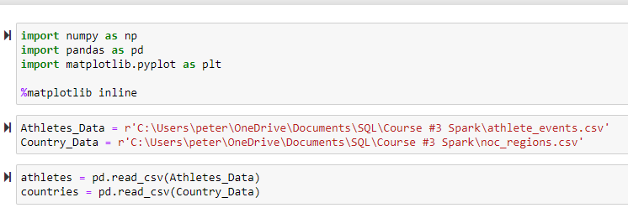
Import Data

Slide 4
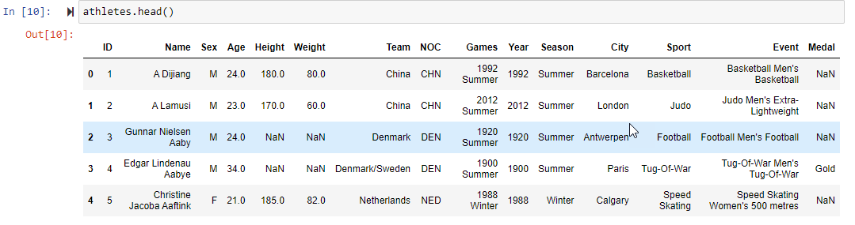
Explore Data

Slide 5
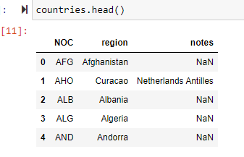
Explore Data (Continued)

Slide 6
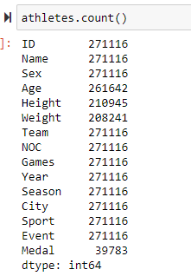
Explore Data (Continued)
All the Features have the same number of values except Medal. When an athlete does not win a medal, the table has “NaN”. This is okay because that will be treated as “0” in counts.

Slide 7
QUESTIONS TO ANSWER
Q1
What are the trends of the number of Women Competing.
Q2
Who are the Top Athletes.
Q3
Since I am from the USA, how is the total number of medals won by the USA changing.
-Obviously likely increasing because participation and the number of events are increasing. But, let’s examine this.

Slide 8
Initial Hypotheses
Q1-The percent of women competing is usually increasing
Q2-Which athletes have won the most medals?
Q3-The numbers of medals won by USA athletes is consistently increasing. Does this fit a Linear Regression model.

Slide 9
Data Analysis Approach
Features (Columns/Fields)
Sex
Medals
Region = USA
Relationships to explore
Male vs. Female
Total medal count per athlete
Total medal count per year for the USA
Metric Evaluation measure
Percent
Sum
Linear Regression

Slide 10
Initial exploration of data
Features (Columns/Fields)
Sex
Medals
Region = USA
Relationships to explore
Male vs. Female
Total medal count per athlete
Total medal count per year for the USA
Metric Evaluation measure
Percent
Sum
Linear Regression

Slide 11
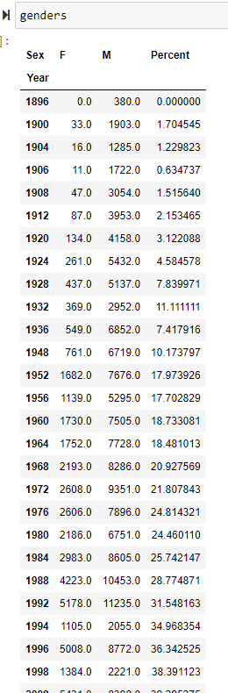
Initial exploration of data

Slide 12
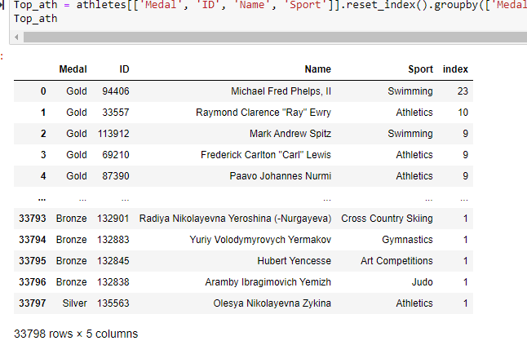
Initial exploration of data

Slide 13
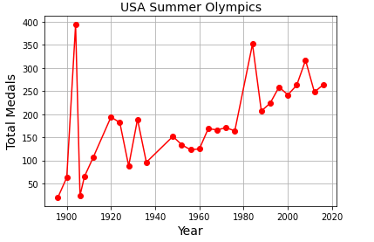
Initial exploration of data

Slide 14
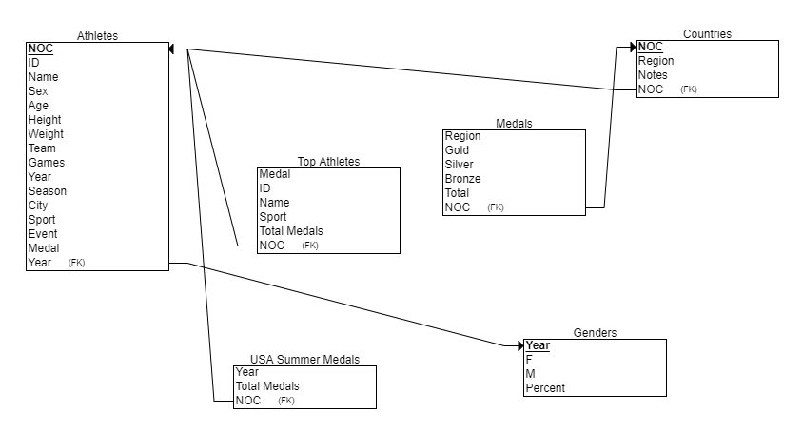
Entity Relationship Diagram (ERD)

Slide 15
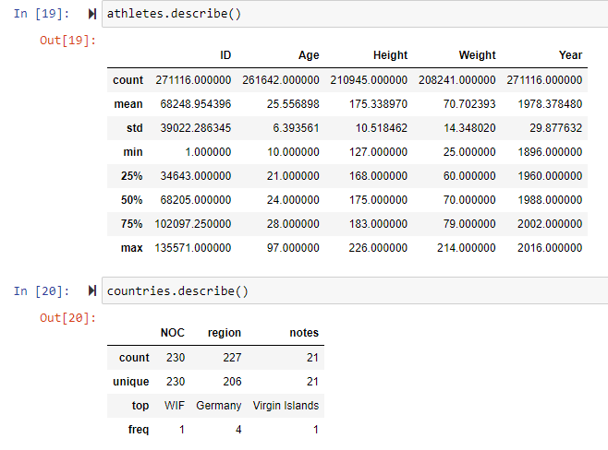
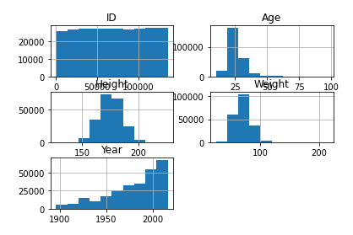
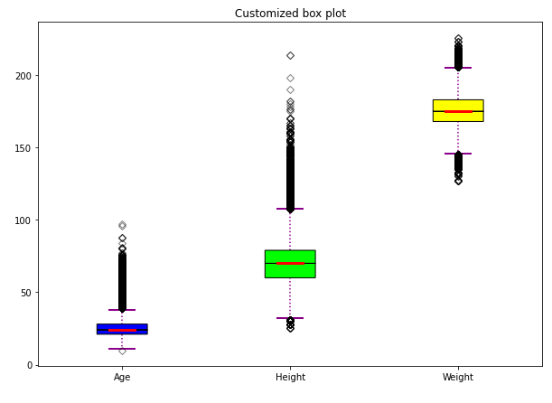
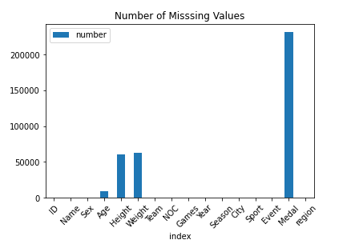
Initial Findings

Slide 16
Initial Findings
In the previous charts, the exploratory analysis shows nothing unexpected.
We examined both the total number of medals won by year and the top ten countries with total medals won. What jumped out was the total started going down by a large amount and then back up every other 2 years, starting in 1994. With some investigation, this was when the Summer and Winter Olympics were split and alternated every 2 years. See the following:

Slide 17
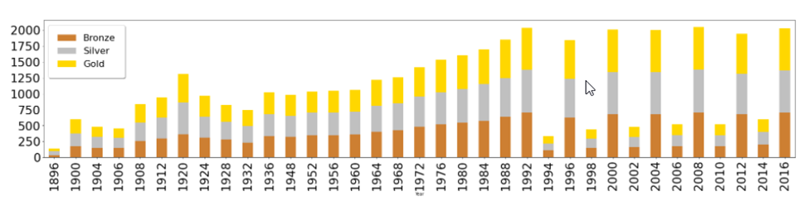
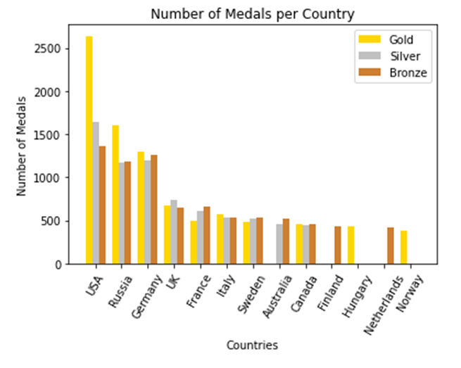
Initial Findings

Slide 18
Deeper Analysis
We looked at the Correlation between Genders (the number of participants). The ‘Year’ and the percent of Female participants had a 0.79 as the correlation between the scores of Year and Percent of Female participants. This indicates that the two columns are somewhat highly correlated in a positive direction. That is, for a higher value in Years we are observing a higher value in Percent of Female participants and vice versa.
We also ran a Linear Regression on the Total number of Medals won by the USA in the Summer Olympics and the Year. The intercept (not really meaningful) and the slope were both statistically significant (~.001) but the R² was only .36 – meaning only about 36% of the data is explained by the regression line. This indicates that Linear Regression might not be a suitable model.

Slide 19
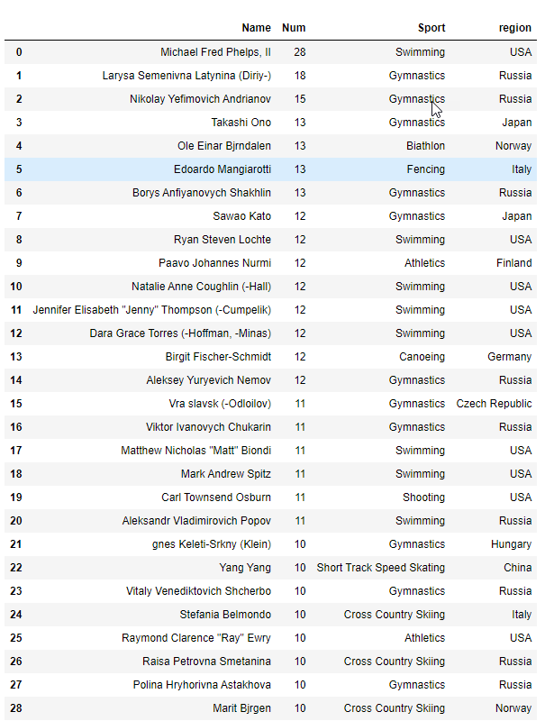
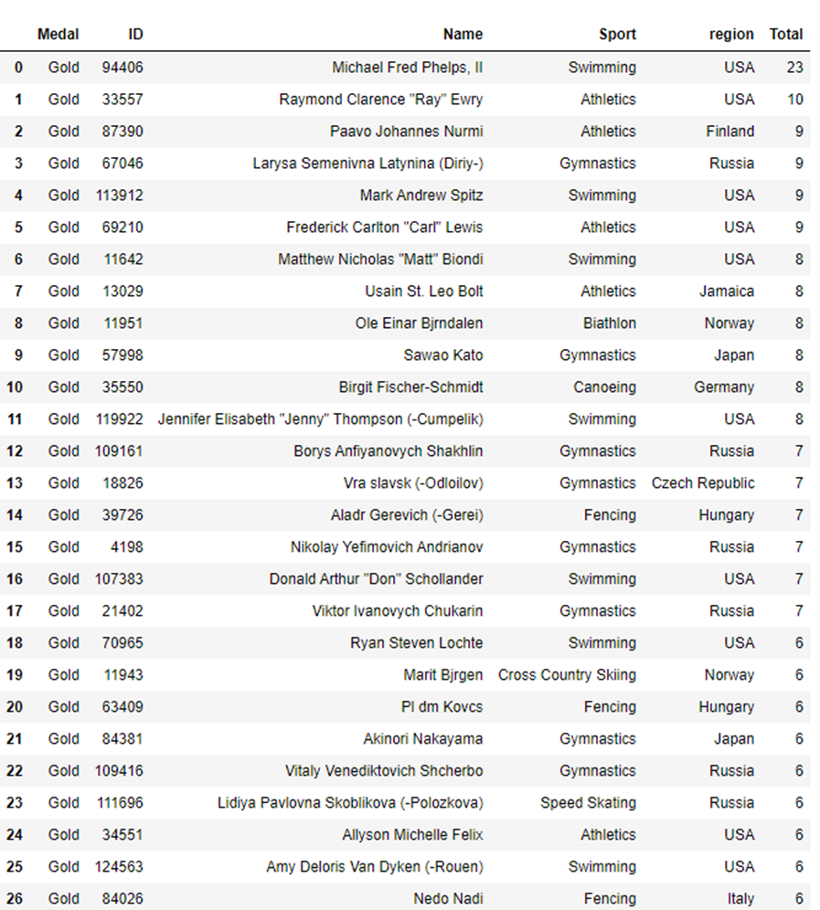
Deeper Analysis
We created the top total medals winners by individual:
And since Gold Medals are the most prestigious, I did the same for just Gold Medals:

Slide 20
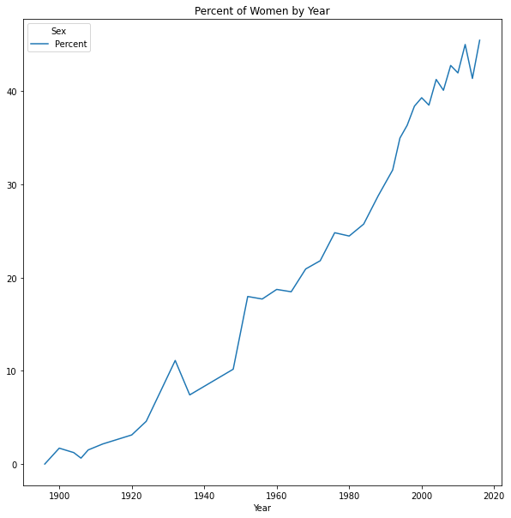
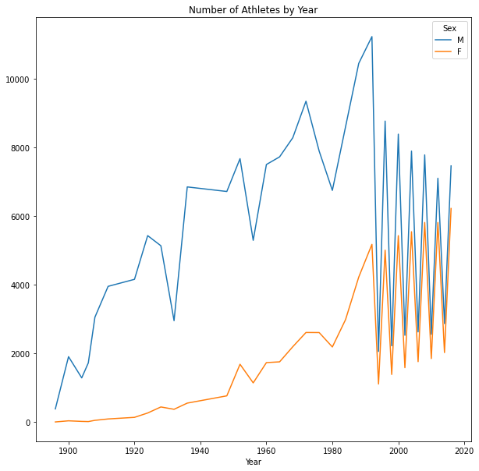
Hypothesis Results
Q1
What are the trends of the number of Women Competing.
H1-The percent of women competing is usually increasing

Slide 21
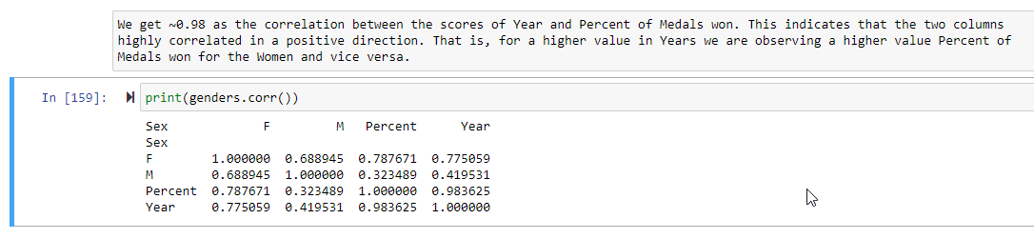
Hypothesis Results
Q1
What are the trends of the number of Women Competing.

Slide 22
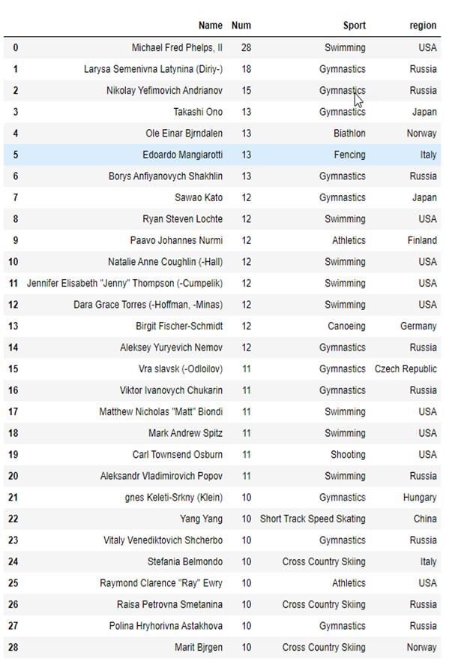
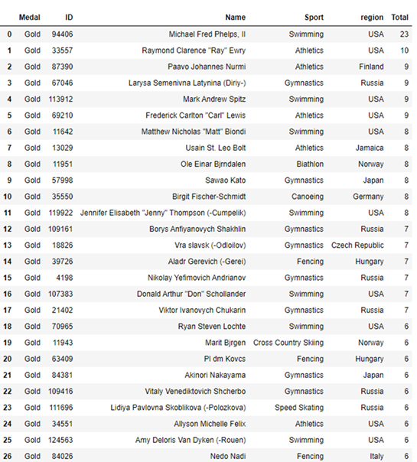
Hypothesis Results
Q2
Who are the Top Athletes.
We created the top total medals winners by individual:
And since Gold Medals are the most prestigious, I did the same for just Gold Medals:
H2-Which athletes have won the most medals?

Slide 23
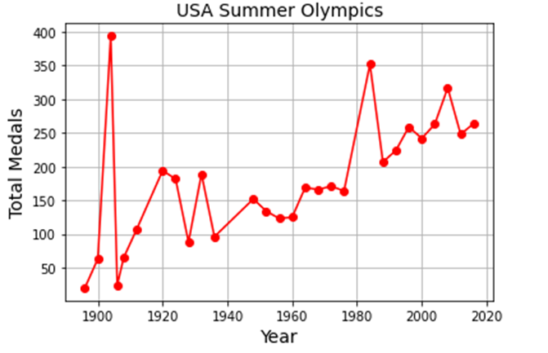
Hypothesis Results
Q3
Since I am from the USA, how is the total number of medals won by the USA changing.
H3-The numbers of medals won by USA athletes is consistently increasing. Does this fit a Linear Regression model?
The correlation coefficient is 0.60 and the two-tailed p-value is .0008. Meaning there is a fairly high positive correlation and since this p-value is less than .05, we would conclude that there is a statistically significant correlation between the two variables. (see next slide)

Slide 24
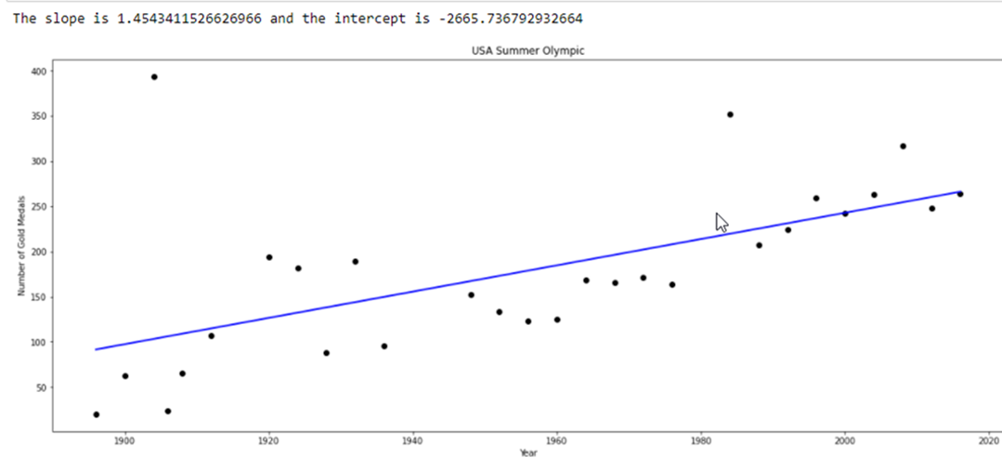
Hypothesis Results
Q3
Since I am from the USA, how is the total number of medals won by the USA changing.
H3-The numbers of medals won by USA athletes is consistently increasing. Does this fit a Linear Regression model?

Slide 25
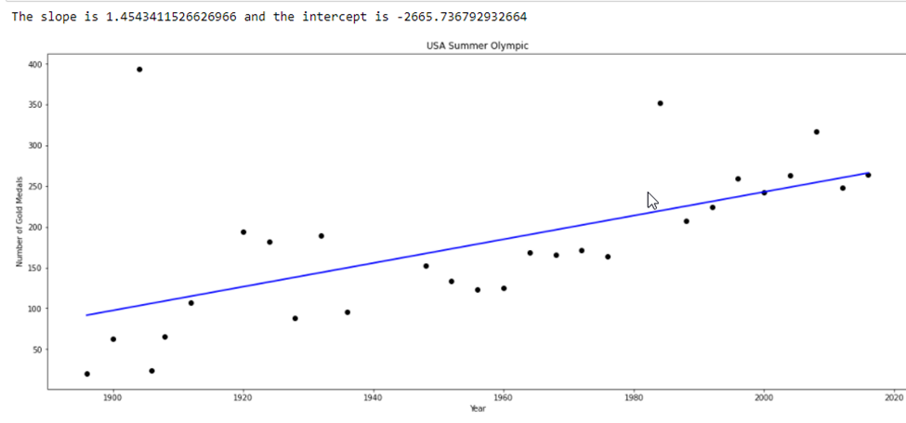
Hypothesis Results
Q3
Since I am from the USA, how is the total number of medals won by the USA changing.
H3-The numbers of medals won by USA athletes is consistently increasing. Does this fit a Linear Regression model?

Slide 26
Link to Jupyter Notebook: The-Olympics-120-Years-of-Data/Olympics_120_Years.ipynb at main · kwpeters58/The-Olympics-120-Years-of-Data (github.com)
END

